Slide 1

CAR PRICE PREDICTION
Submitted By:
Albin Reji

Slide 2
Problem Statement
With the covid 19 impact in the market, we have seen lot of changes in the car market. Now some cars are in demand hence making them costly and some are not in demand hence cheaper. One of our clients works with small traders, who sell used cars. With the change in market due to covid 19 impact, our client is facing problems with their previous car price valuation machine learning models. So, they are looking for new machine learning models from new data. We have to make car price valuation model.

Slide 3
Understanding
Build a model which can be used to predict in terms of a probability for each car pricing factor, .
The motive behind this project is to create a ML model that predicts with the given conditions the price of a car resold.

Slide 4
EDA
Removing unwanted columns.
Checking the distribution.
Plotting Correlation.
Removing columns with low correlation.
Removing correlation pairs.
Checking outliers.
Checking skewness
Encoding
Scaling

Slide 5
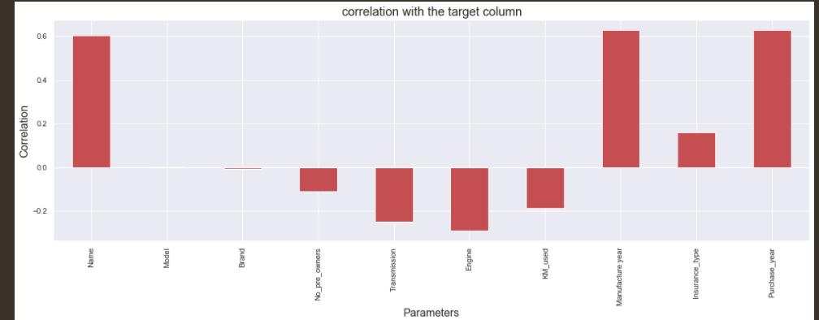
Visualizations
Correlation

Slide 6
Steps
These are the models that I’ve tested to find the best model.
Linear Regression
K-Neighbors Regressor
Decision Tree Regressor
SVR
Random Forest Regressor
Lasso
Ridge
Elastic Net

Slide 7
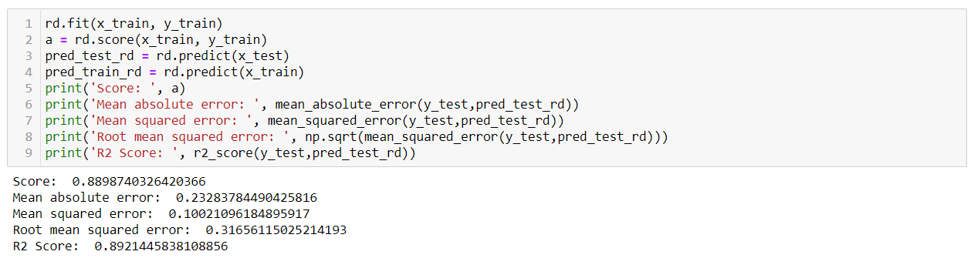
Model dashboard

Slide 8
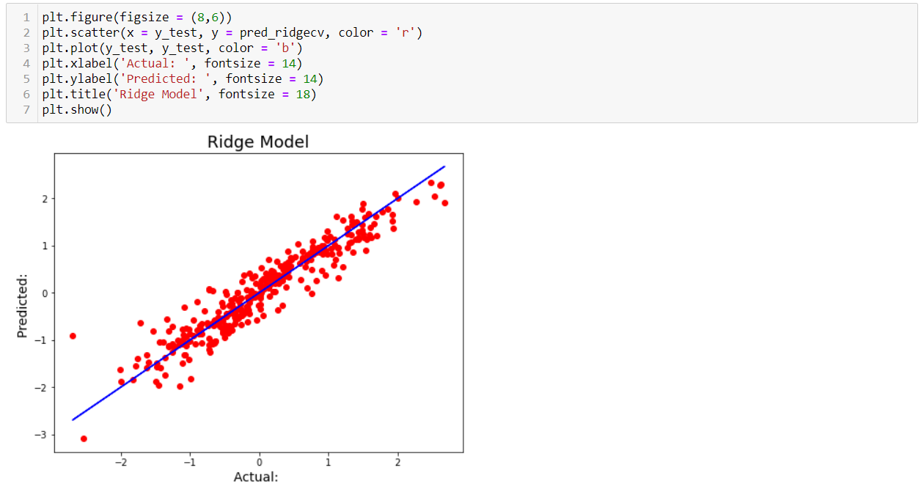
Finalized model
We have finalized the best model to be Ridge Regression

Slide 9
Conclusion
We’re getting a model with about 91.2% accuracy post Cross Validation and Grid Search CV with all listed parameters.
Both Lasso and Ridge models gave a good R2 Score in the preliminary run, but on further inspection, Ridge turned out to be the best working model. On further running with the Cross validation, we were able to find that the difference between R2 Score and CV score were less for all the models, however, I went with ridge taking into consideration the low difference in values for all the models and the comparatively higher score for the Ridge Model.
I have created a model which gives me a good accuracy in terms of predicting the prospect price of a house with the parameters listed.

